Slide 1
Project Cuboid
Robert Baines, Andrew Morgan, Hayley McClintock

Slide 2
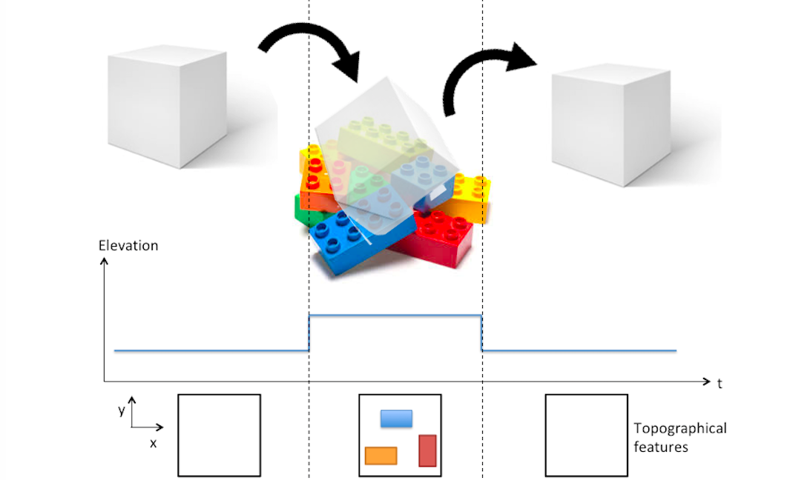
Problem Statement
A cuboid with a dynamic contact surface for adaptable motion and topographic mapping on variable terrains.

Slide 3
Approach
Construct a cube where 4 faces contain an array of solenoids (or other actuators)
Solenoids actuate the cube and serve as sensing elements
Soft skin wrapped around the outside to prevent debris from interfering with solenoids in addition to providing better surface for rolling
Incorporation of pressure sensors elastically coupled to solenoids for mapping the environment

Slide 4
Evaluation
Cuboid will “roll” over an obstacle course
Make a topographical map based on sensor feedback
Successfully overcome various elevation obstacles
Obstacles may include but are not limited to:
Legos
Office supplies (pens,paperclips, etc.)
Quality metrics:
Euclidean error based on ground truth
Notes:
Interesting to see the resolution we can get out of the pressure sensors

Slide 5



Deliverables
10/12
Order initial testing components
CAD model and design
Electronic architecture diagram
Complete solenoid testing
11/2
Prototype I constructed
Sensor calibration
Testing plan
12/3
Final cube finished
Achieve topographical mapping
Locomote over obstacle course

Slide 6
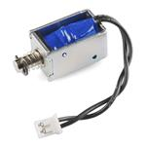
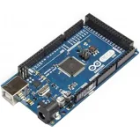
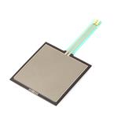
Resources
Solenoids (20 at $7.99 each)
Arduino or other microcontroller with peripherals
Megan 2560 for required number of inputs
Relay arrays (25 at $2 each)
Reduction to 5 if desired
IMU ($20)
Prior calibration required
Key component to sensing acceleration based on actuation input
Pressure sensors (25 at $8 each)

Slide 7
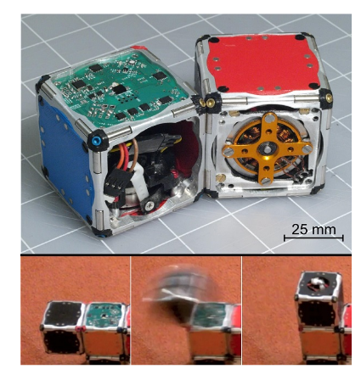
Cubes in the literature
[Romanishin et al.]
[Gajamohan et al.]

